Slide 1





Building a web-based application
that manages activities of the Maid Service
Group 6

Slide 2
Introduction
Supervisor:
Mr. Nguyễn Trọng Tài
Bùi Tiến Tuân
Nguyễn Tấn Công
Mạnh Quang Tuyến
Member

Slide 3
OUTLINE
Scenario Problem
Pros & Cons of Current System
Proposed System
Features
Demo
Achievement, Disadvantages and Future Plan
Questions and Answers

Slide 4


Scenario Problem
Maid service
Customer
Search maid
Hire maid
Maid
Find job
Payment
Apply

Slide 5
Current Systems
timviecnhanh.com
giupviectheogio.vn
Notes:
-Đăng xong rồi phải tự tìm. Chứ không có suggest
-

Slide 6
Current Systems
Not auto suggesting
Maid must have IT knowledge
Notes:
Đưa các hình về việc không có đại diện, không có suggest

Slide 7
Solution
Have maid mediator role
Auto suggest
Notes:
-

Slide 8
Proposed System
Customer
Apply maid
Maid Mediator
Manage maid
Staff
Manage all requests & payment
Suggest
System
Admin
Manage account & config
Notes:
Maid Mediator
Chỉ là người quen, không đóng vai trò môi giới. Chẳng qua chỉ là người biết CNTT để tương tác. Phiếu thu ghi cho maid

Slide 9

Features
Customer
Post recruitment
Apply job request
Maid mediator
Manage maid
Post job request

Slide 10


Features
Staff
Post job request
Manage job request & recruitment
Admin
Manage config
Manage account
Manage maid
Manage payment

Slide 11
Demo
Flow 1
Flow 2

Slide 12
Flow 1: Maid mediator and Staff Demo
Maid mediator creates job request
Maid mediator posts job request
Maid or maid mediator comes to pay for job request
Staff activates job request

Slide 13
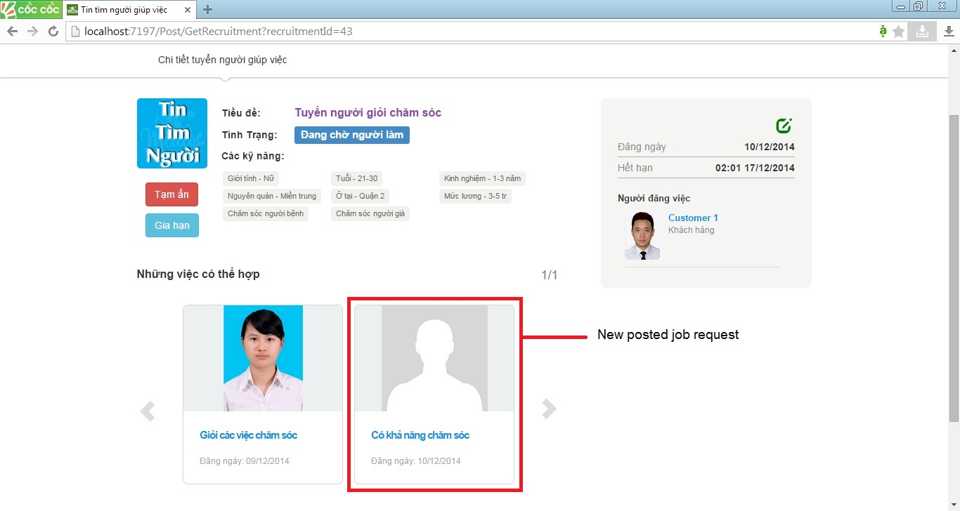
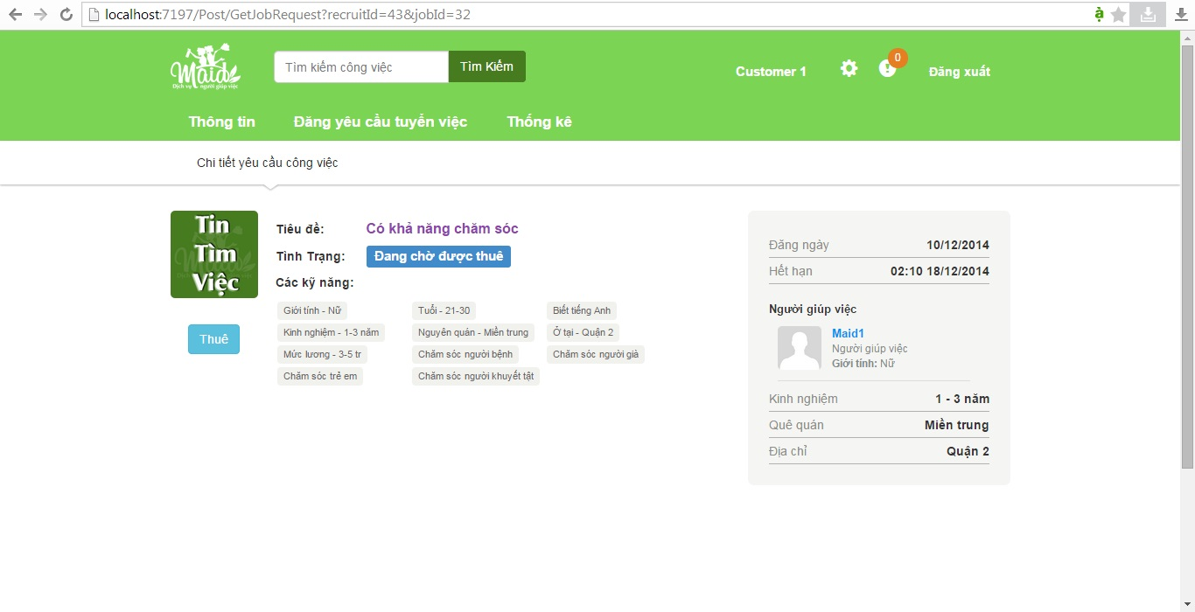
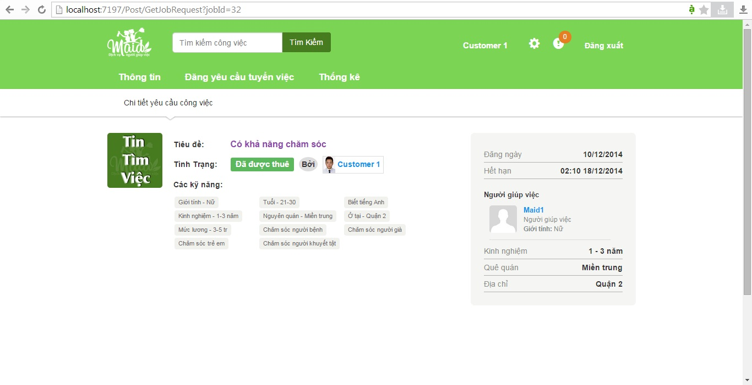
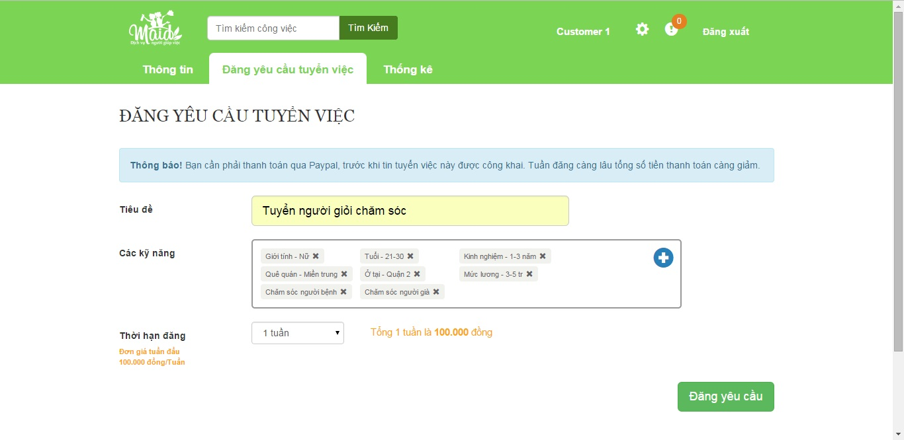
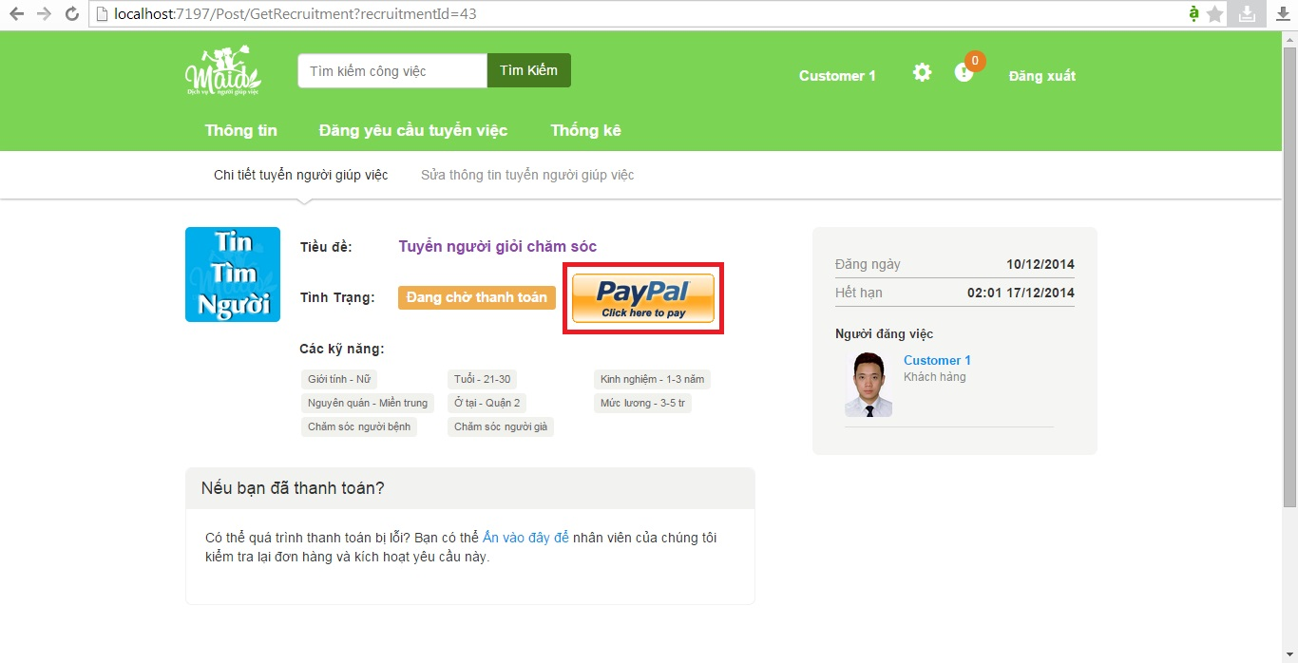


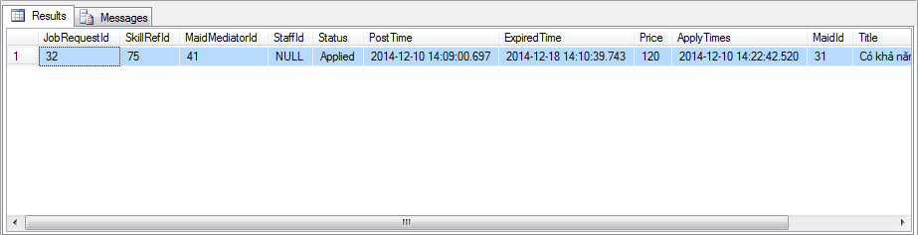
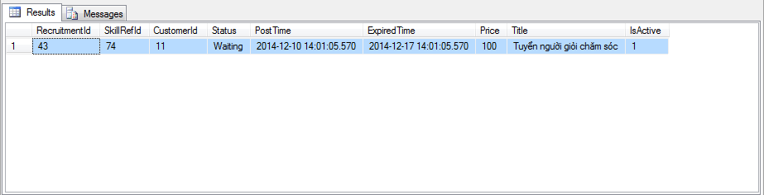
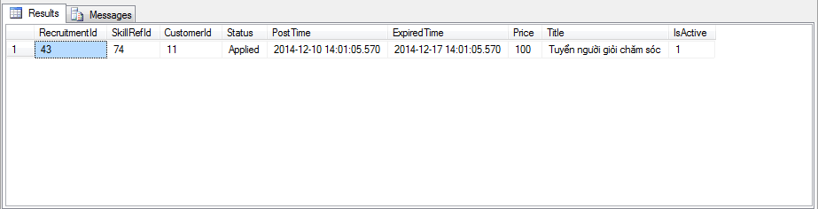
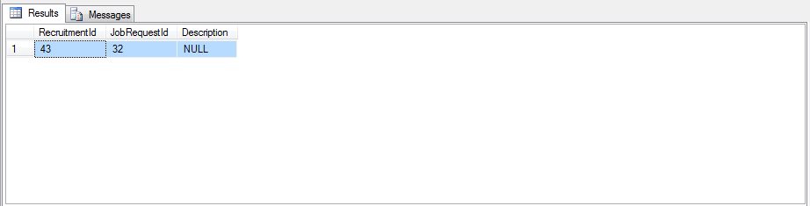
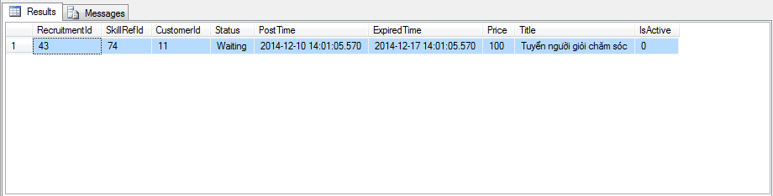



Flow2. Customer Scenario Demo
Customer 1
Post a new recruitment
Pay on PayPal
Hire suggested job request
View suggested job request
Show posted recruitment

Slide 14
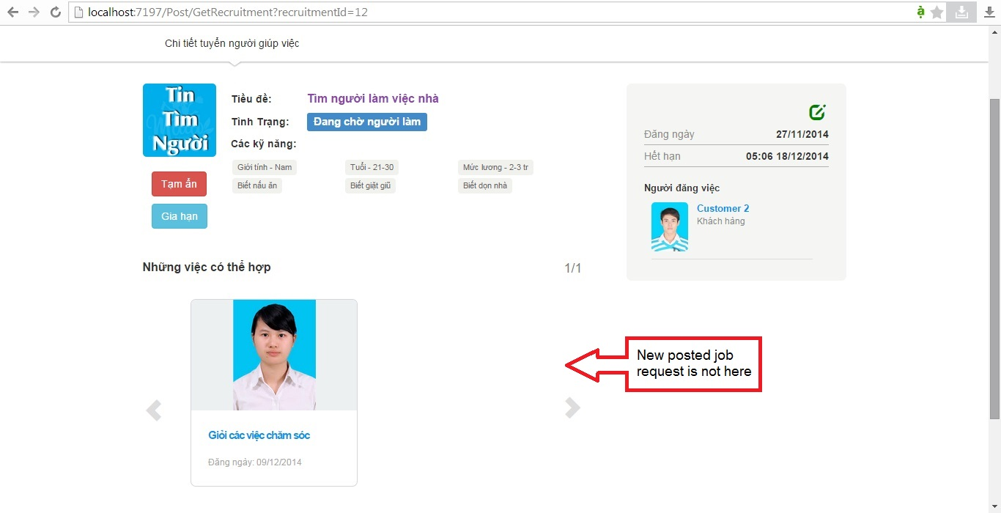
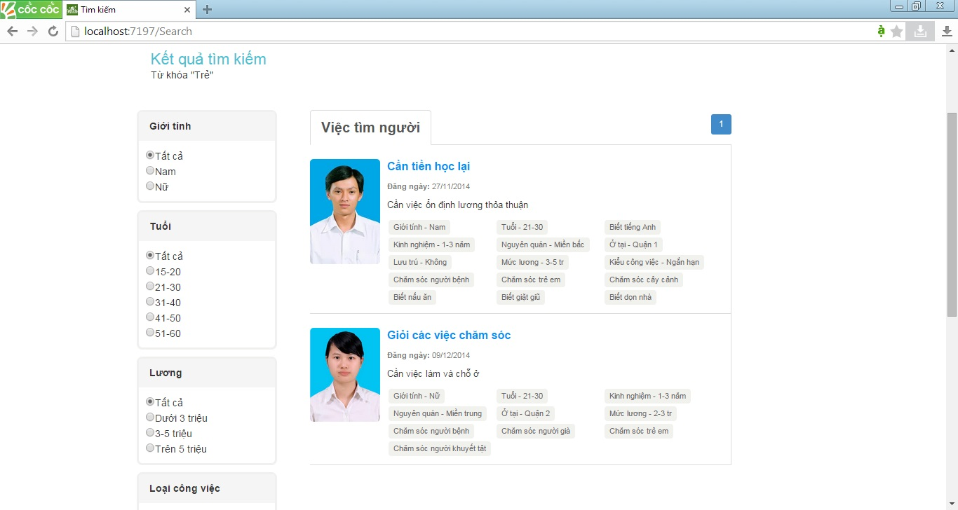
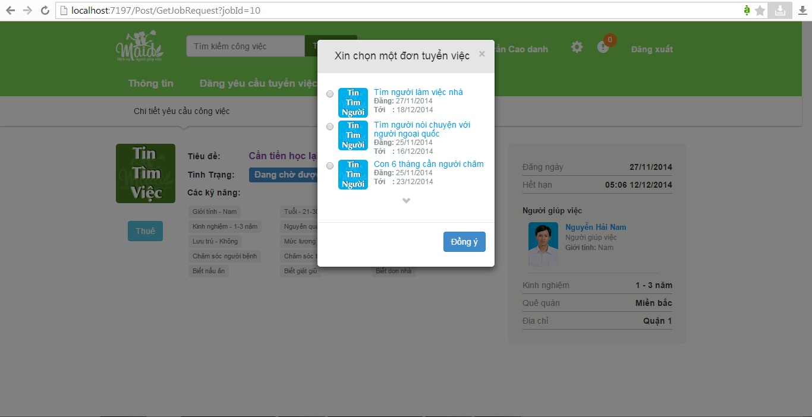

Flow2. Customer Scenario Demo
Customer 2
View an existing recruitment
Search job request
View searched job request
Apply searched job request

Slide 15
Recruitment
Nữ
21-30
1-3 năm
Miền trung
Quận 2
3-5 tr
Chăm sóc già
Chăm bệnh
Profile
Nữ
Quận 2
Miền trung
21-30 tuổi
1-3 năm
Suggest
Match
Job Request
Chăm bệnh
Chăm già
Chăm trẻ
Chăm khuyết tật
3-5tr

Slide 16
Recruitment
Profile
Suggest
Not Match
Job Request
Group 6
Maid Service
16

Slide 17




Achievements
Save time for users.
Easy deployment.
Less hand work.

Slide 18
Disadvantages
Only online payment by PayPal service.
Hard to manage human problem.

Slide 19




Future Plan
Online payment with more services.
Build mobile app.

Slide 20
Technology & Tools
Visual Studio 2012
SQL Server 2008 R2
ASP.NET MVC4
JavaScript
JQuery
Bootstrap

Slide 21
Questions and Answers
THANK YOU VERY MUCH!

